Slide 1
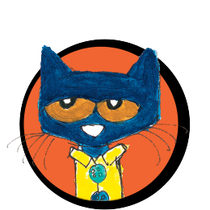
WELCOME to
Ms. Librandi’s
Pete the Cat Virtual Library

Slide 2
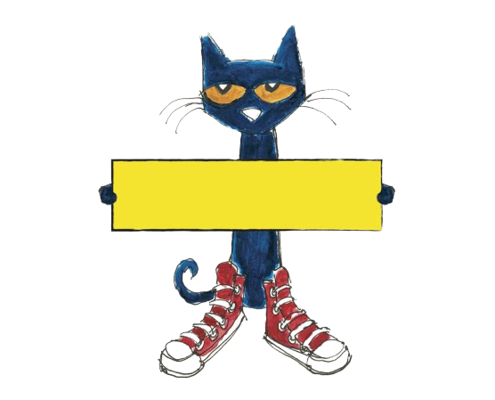
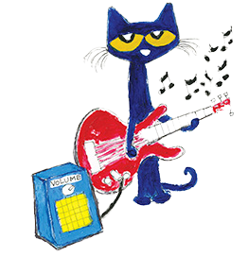
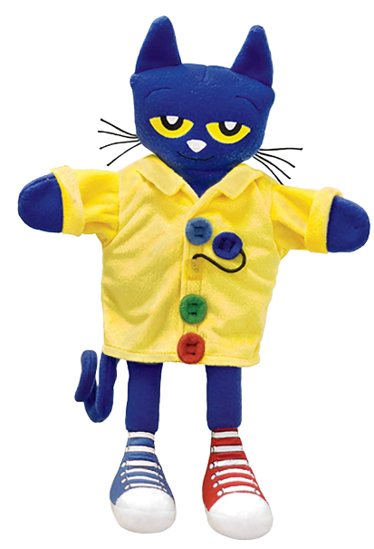
Reading is Fun!
*Click on Pete the Cat graphics and books to enjoy stories and songs.

